Slide 1

Banking Data Analysis By Using SQL
REPORT(USING MYSQL)
SAKSHI SONI

Slide 2
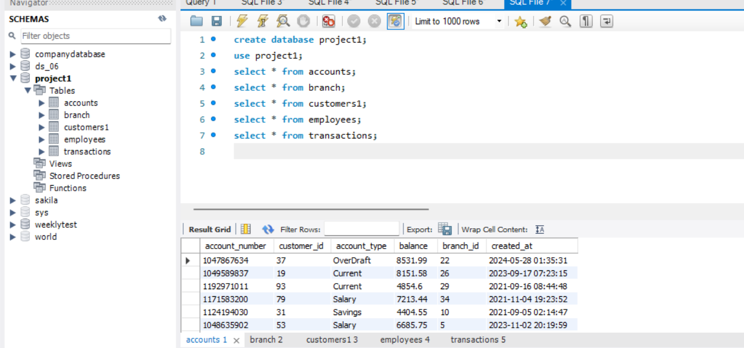
Tables that are included in this project

Slide 3
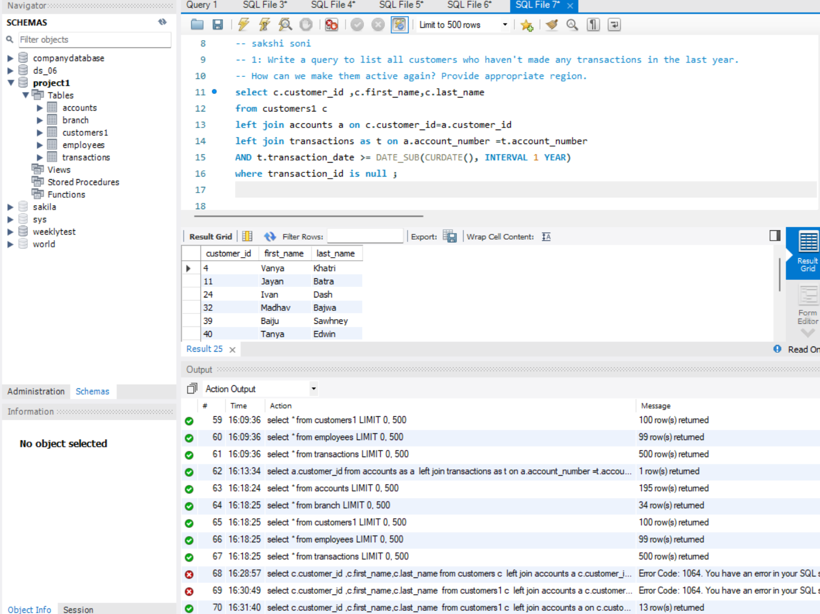
1.Customers with no transaction in last year
1: Write a query to list all customers who haven't made any transactions in the last year. How can we make them active again? Provide appropriate region.

Slide 4
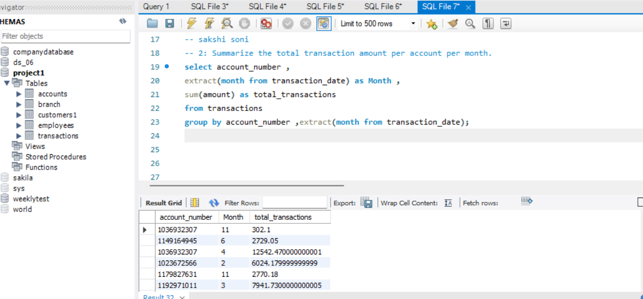
2.Monthly transaction summary per account
Summarize the total transaction amount per account per month.

Slide 5
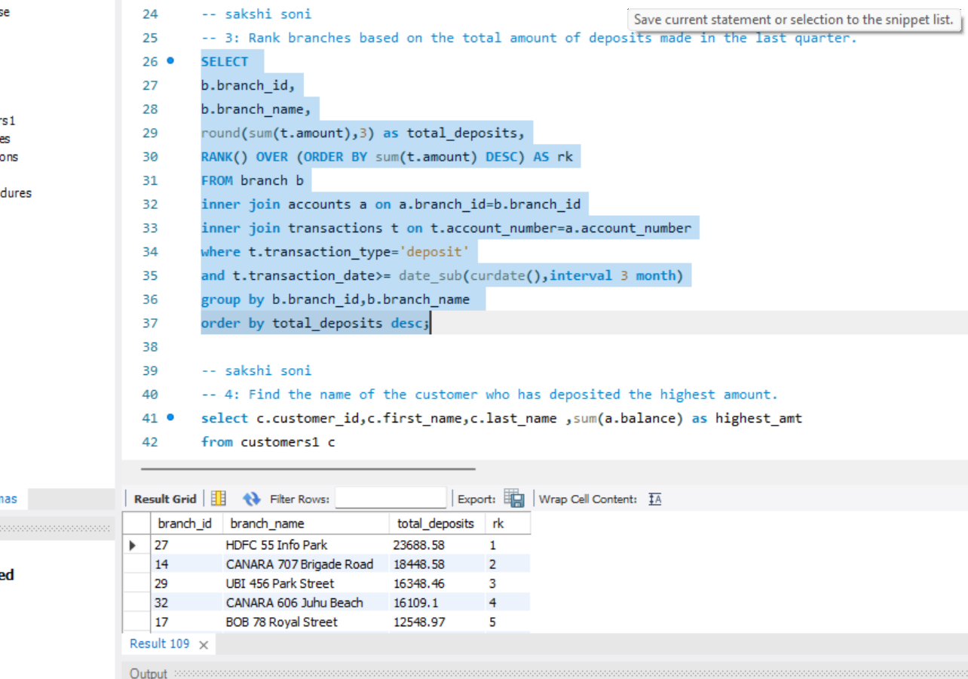
Branch ranking by deposits
Rank branches based on the total amount of deposits made in the last quarter.

Slide 6
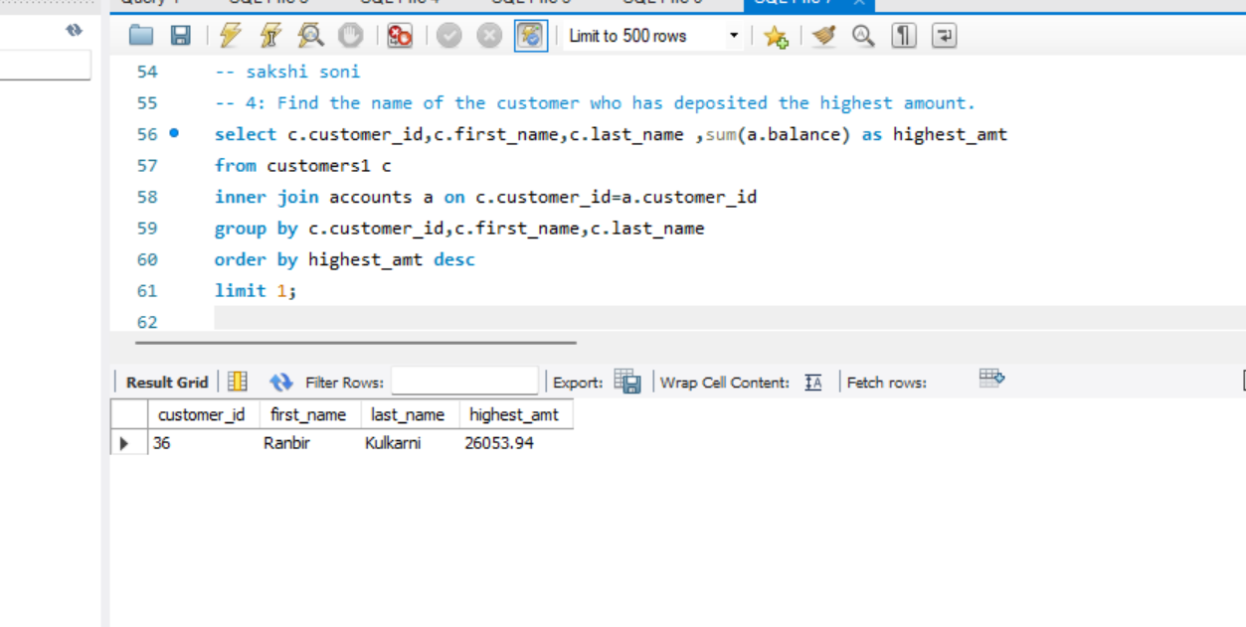
Customer with highest deposits
Find the name of the customer who has deposited the highest amount.

Slide 7
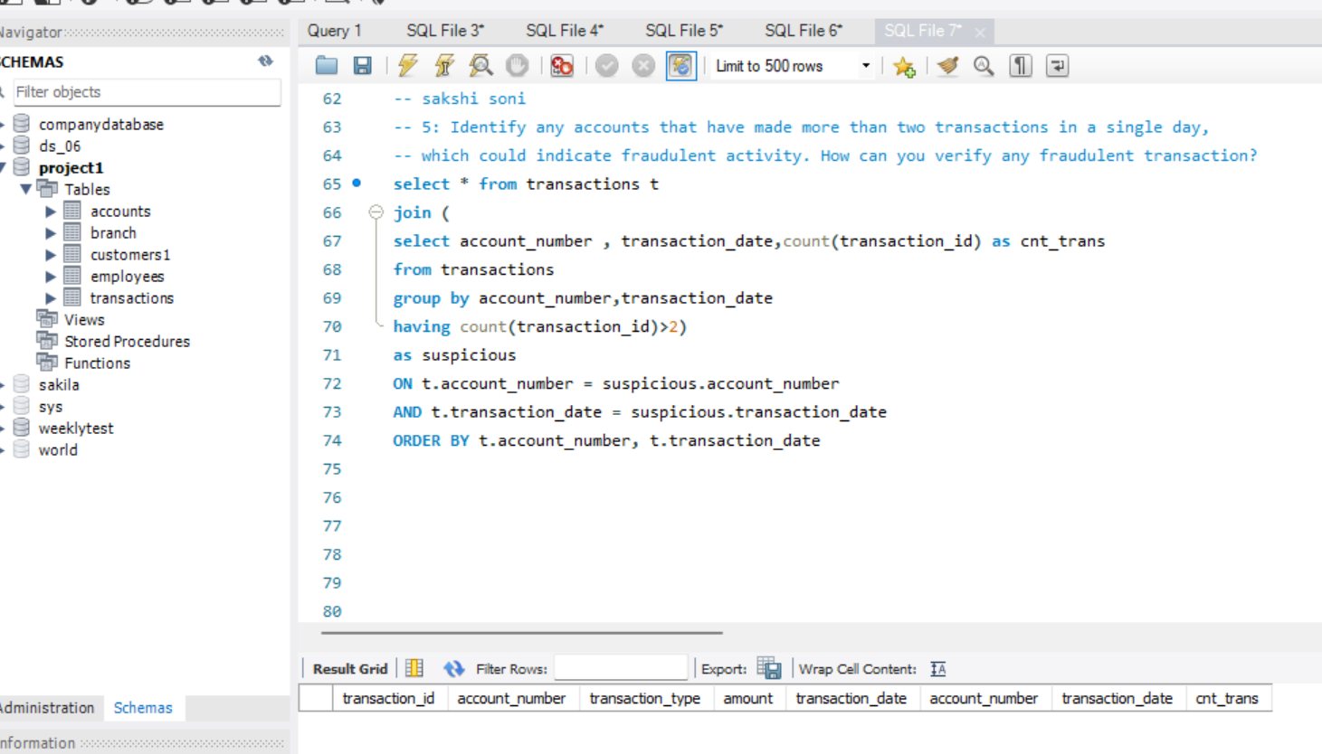
5.Potential fraudulent Activity detection
Identify any accounts that have made more than two transactions in a single day, which could indicate fraudulent activity. How can you verify any fraudulent transaction?

Slide 8
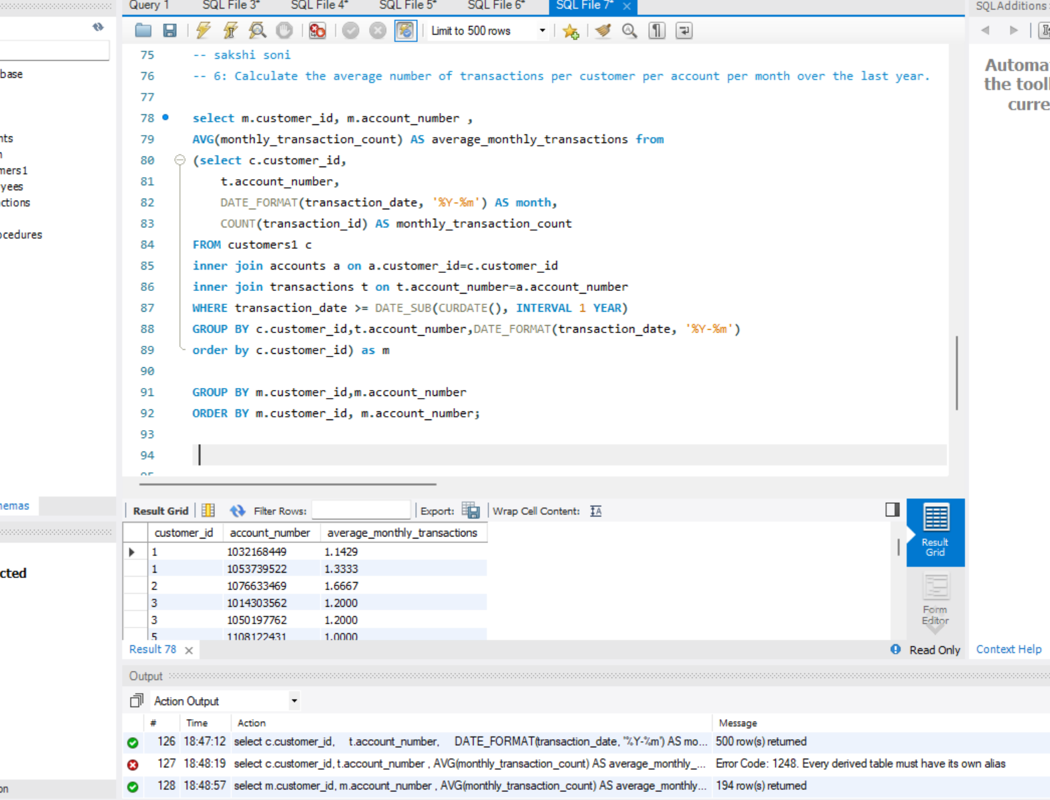
Average transaction per customer per account per month
Calculate the average number of transactions per customer per account per month over the last year

Slide 9
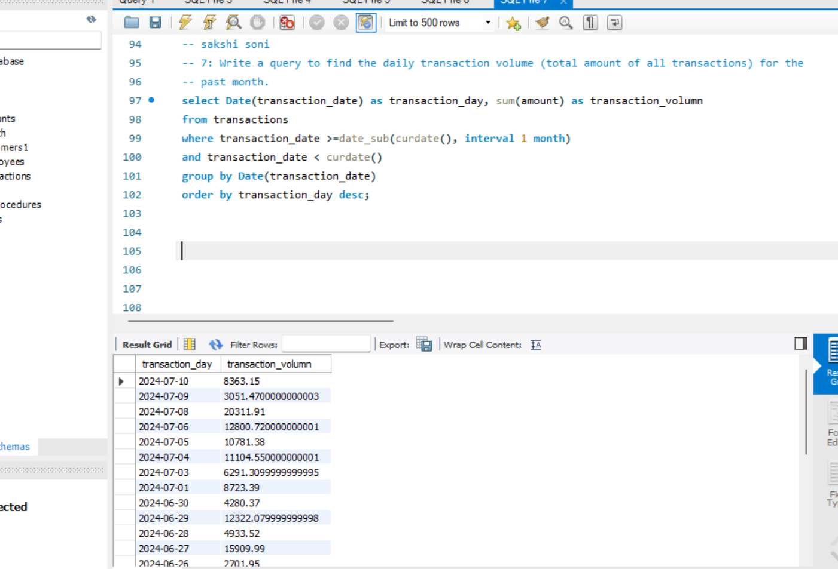
Daily transaction volumne
Write a query to find the daily transaction volume (total amount of all transactions) for the past month.

Slide 10
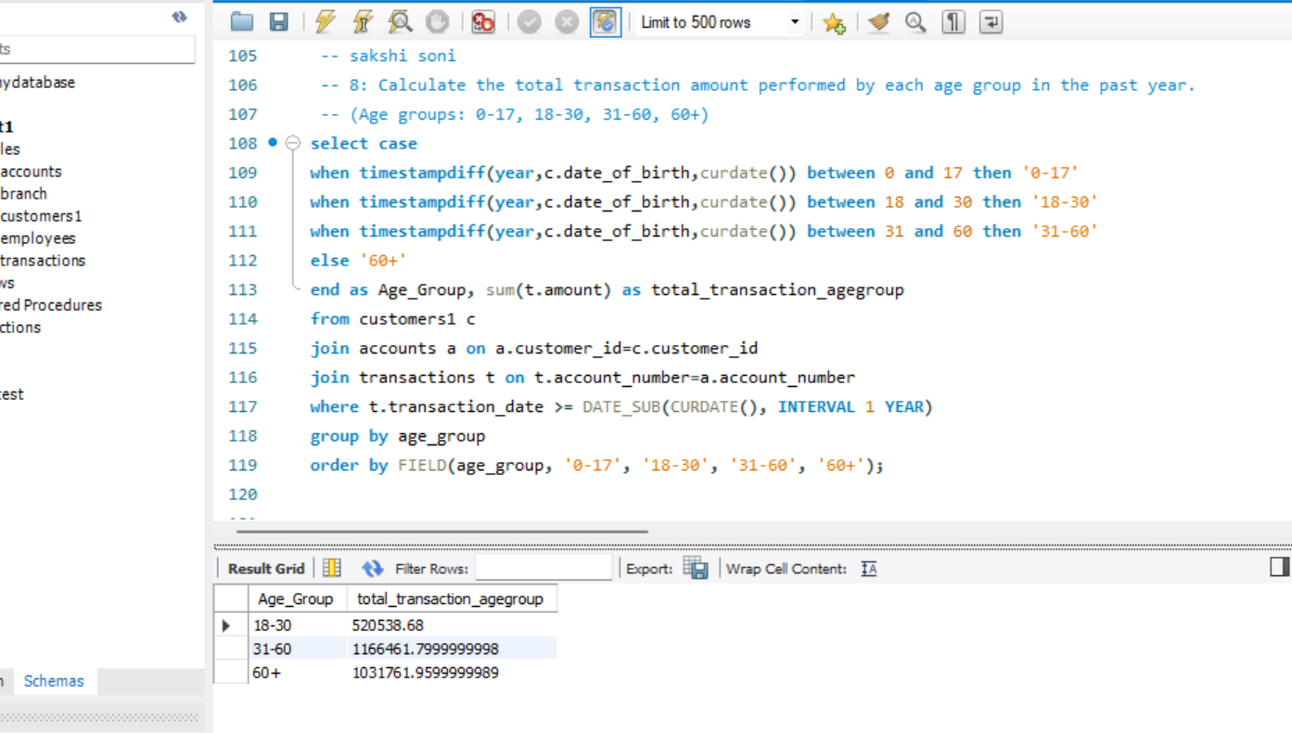
Transaction amount by age group
Calculate the total transaction amount performed by each age group in the past year. (Age groups: 0-17, 18-30, 31-60, 60+)

Slide 11
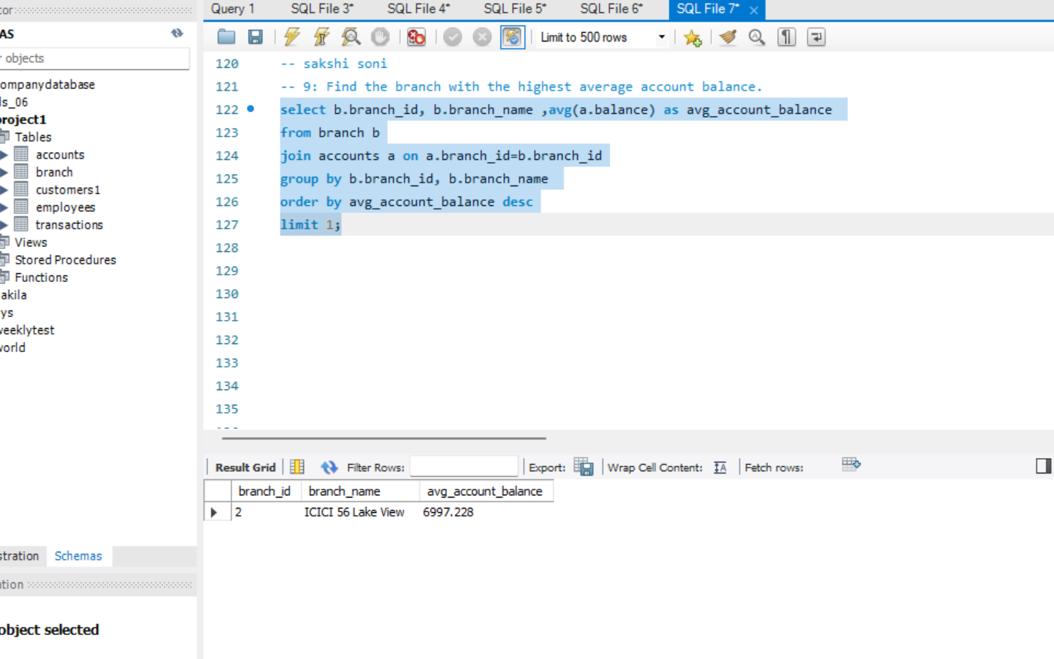
Branch with highest average account balance
Find the branch with the highest average account balance.

Slide 12
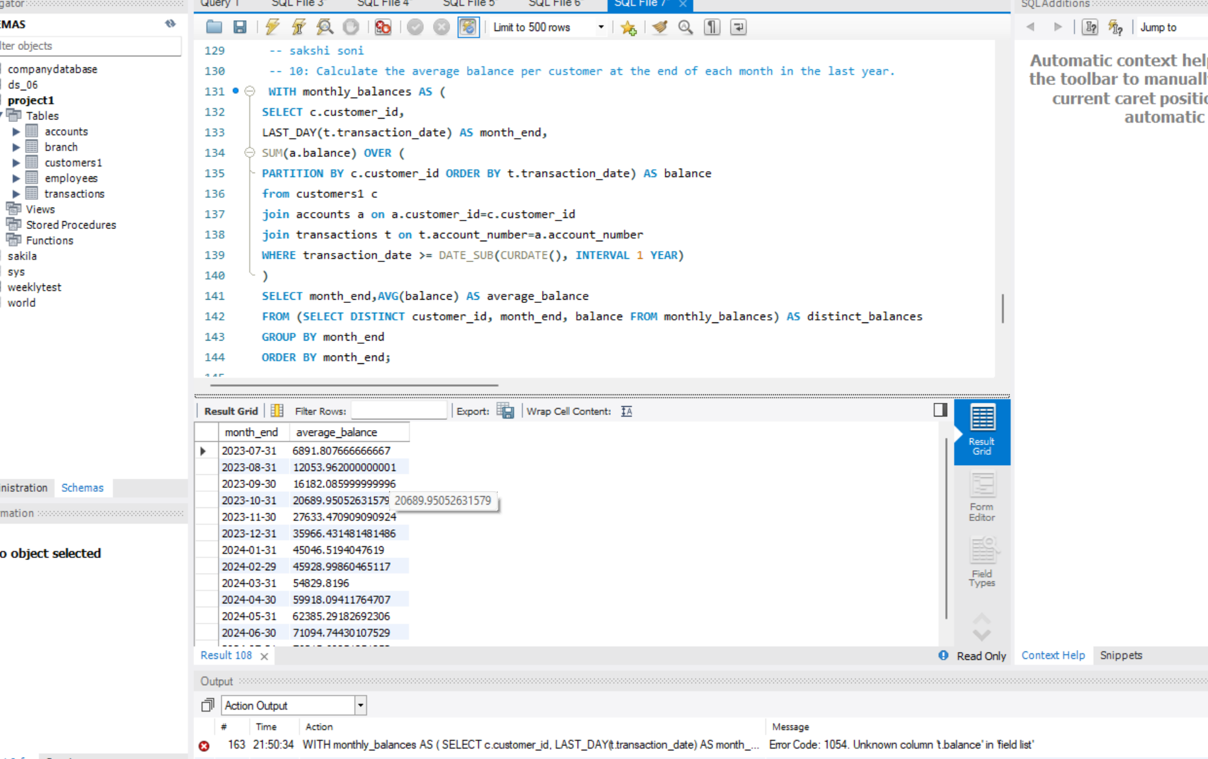
Average balance per customer monthly
Calculate the average balance per customer at the end of each month in the last year.

Slide 13

Conclusion
This analysis provides crucial insights into customer behavior, performance, fraudulent activities, etc. The queries help me to make decisions where I have to improve the things happening in the industry .

